Slide 1
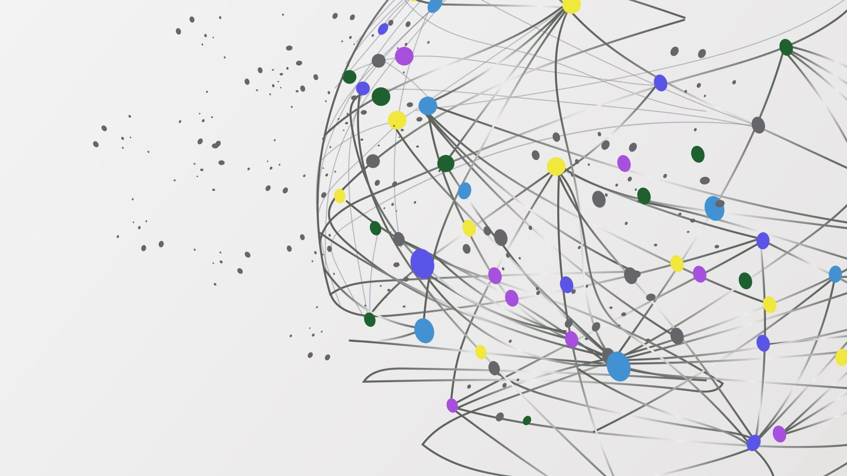
FlexType EMG Keyboard
Half-Byte Solutions
Julia Johnson
Giancarlos Hernandez Mendoza
Jalen Tottress
Kejon IverY

Slide 2
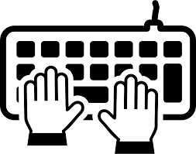
Project Introduction
Problem Statement
A lot of people in the digital era uses a cellphone, laptop, or tablet daily to conduct daily activities. Yet for those who may not be able to do the same due to lack of fine muscle movement, there is nothing on the current market for this group of people. With that being said, what if there was a product to bridge the gap between fine motor limitation and digital autonomy.
Our Solution
An electromyography keyboard that does not depend on fine motor movements
Intended Users & Applications
Those who have limited fine motor control and want autonomy when engaging with the digital world

Slide 3

Market Research
Target Users
Individuals with limited fine motor control
People who have difficulty using standard keyboards
Existing Solutions
Voice-to-text
Wearable EMG devices (Meta Wristband)
Assistive input devices (Eye Tracking)
Gaps
Voice inputs can lack privacy and reliability in noisy environments
Existing solutions can have steep learning curve, be expensive, or are too heavy to carry around
How We're Different
The FlexType EMG Keyboard utilizes the user's muscle signals via a range of gestures to type words, with the help of a word prediction model
Designed with low-effort movements to support our target audience.
We are more private and discreet than voice-based systems
Cheaper than most existing solutions

Slide 4
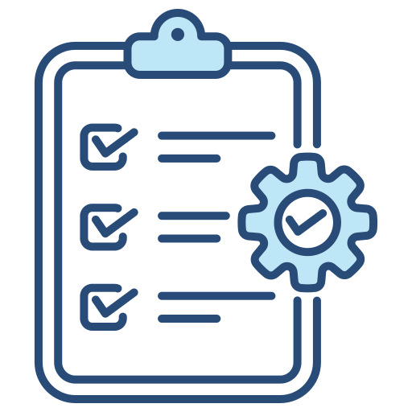
Product Requirements
Top Functional Requirements
EMG Wristband shall operate in low-power mode when not actively used
EMG wristband that converts analog EMG signal to digital
Wearable Device that transmits data
Key Performance Targets
Gesture classification of 90% accuracy and above
Word Prediction of 90% accuracy and above
The EMG Wristband shall "wakeup" within 5 seconds of activation gesture
Constraints & Assumptions
An economic constraint would be which EMG sensor to use, we opted to use 2-channel instead of 8 since the cost would be significantly cheaper
Gathering EMG data was entirely dependent on the schedule of those who volunteered and the availability of the lab
The product needs to be lightweight enough for the target audience to maneuver around and use the wristband as intended
The system's temperature operational range shall be 0°C to 50°C.

Slide 5
System Design Overview: Hardware Subsystem
Electrode Board
Control Board
Screw-type Electrodes
Raspberry Pi
FFC
MCP3464R ADC
USB
INA333 Instrumentation amp
Gesture Model
Word Prediction Model
STM32C071 MCU SPI -> USB bridge
OPA2320 Signal conditioning

Slide 6
System Design Overview: Software Subsystem
Gesture Recognition Model
Word Prediction Model
Process Data
Driver
Predicts Gestures using live data
8 Channels
TensorFlow Framework
N-gram Model
Converts Gestures into commands and coordinates
60Hz Notch Filter
3 Layer, 1D CNN
Runs on remote server
20 – 80 Hz Bandpass Filter
Calls Word Prediction Model API
250ms Window Size
8 Gestures + Rest
Generates the 3 most likely words
Displays Predicted Word/Message

Slide 7
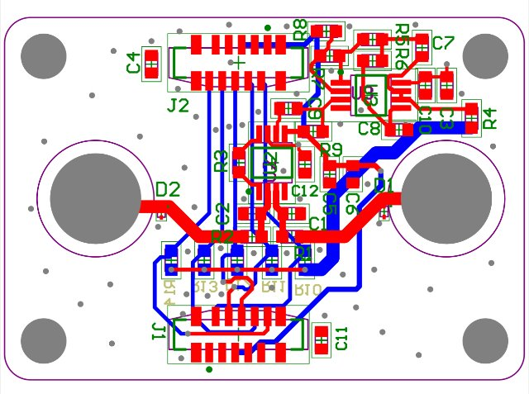
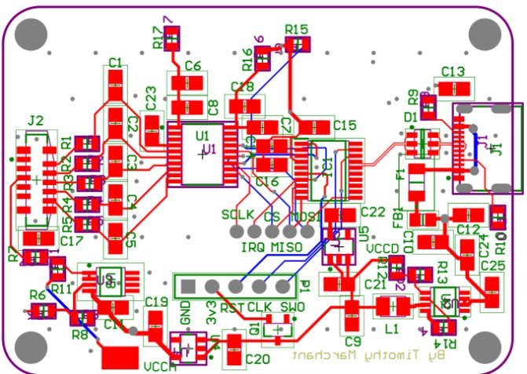
Hardware Prototype: PCB Design
Control Board PCB
Control Board PCB

Slide 8
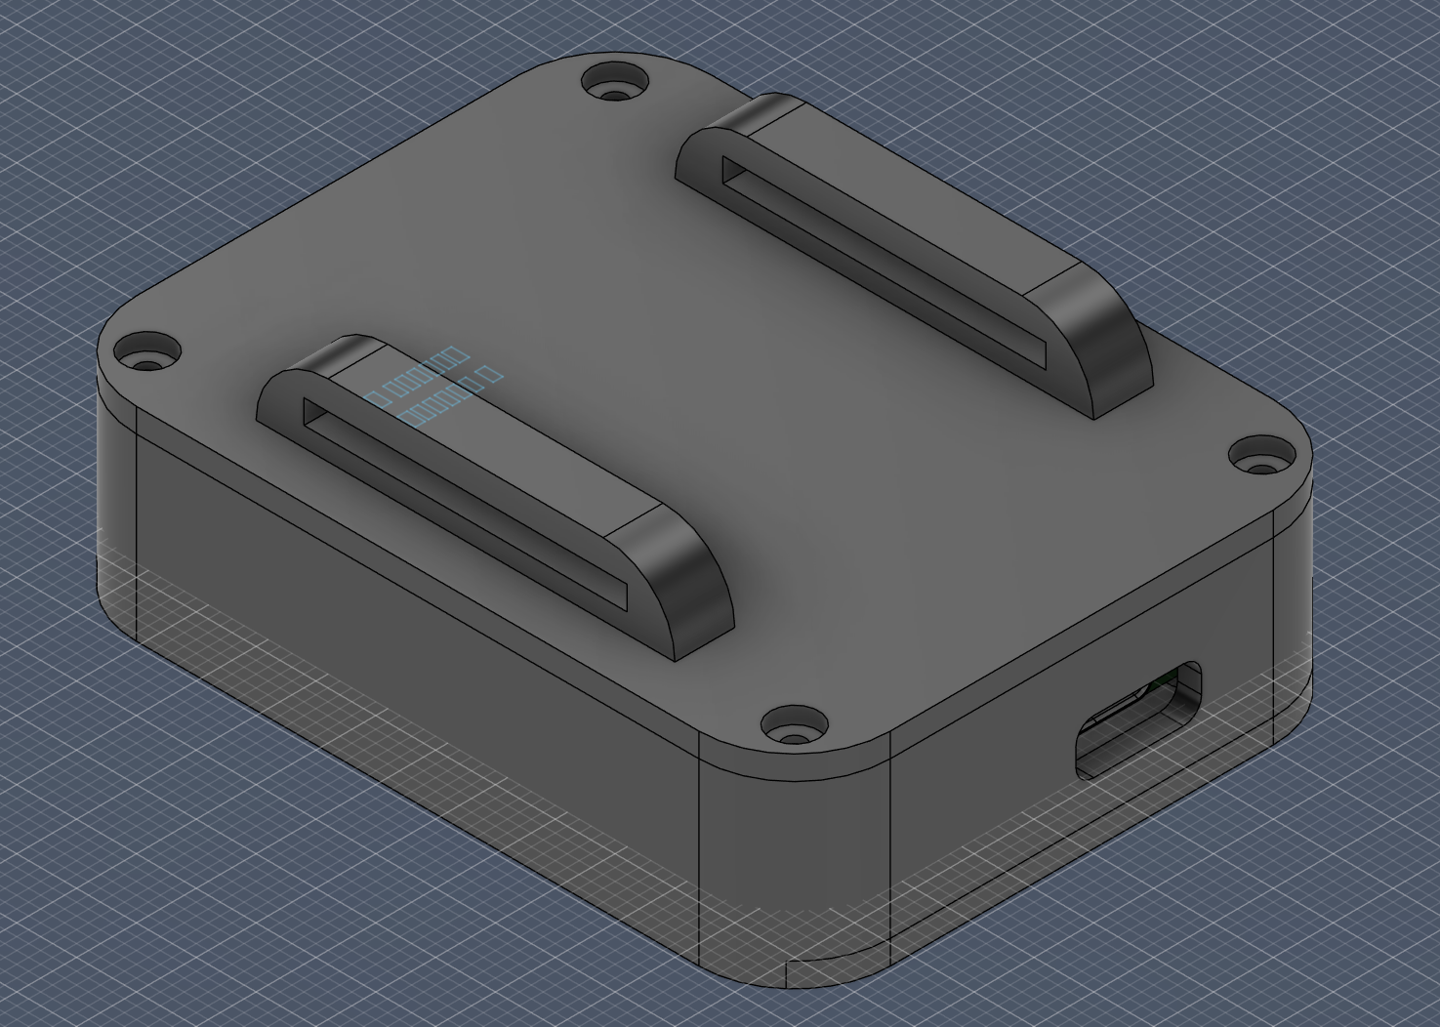
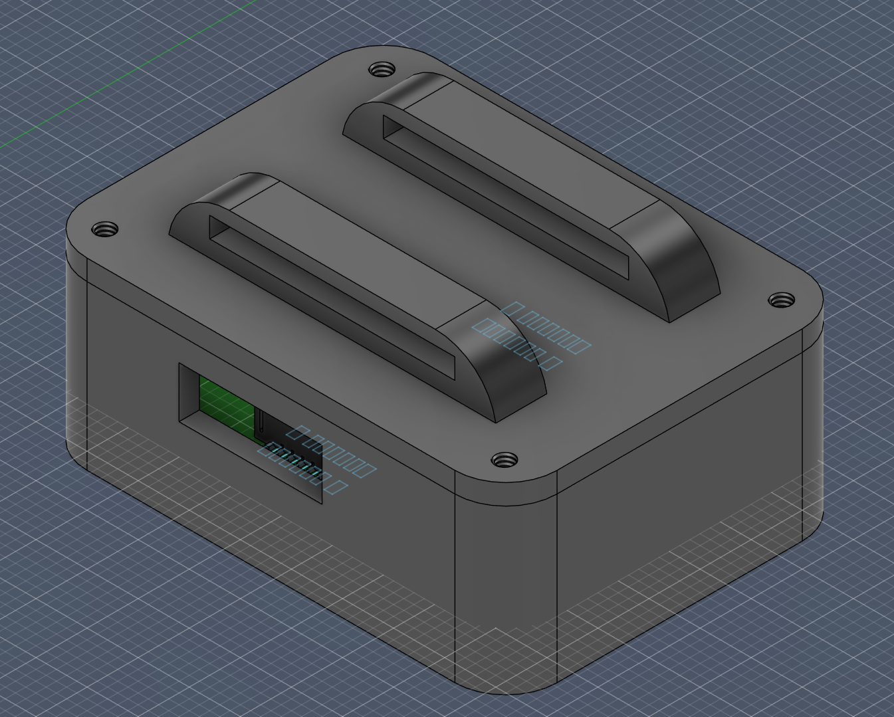
Hardware Prototype: 3D Enclosure
Control Board 3D Model
Control Board 3D Model

Slide 9
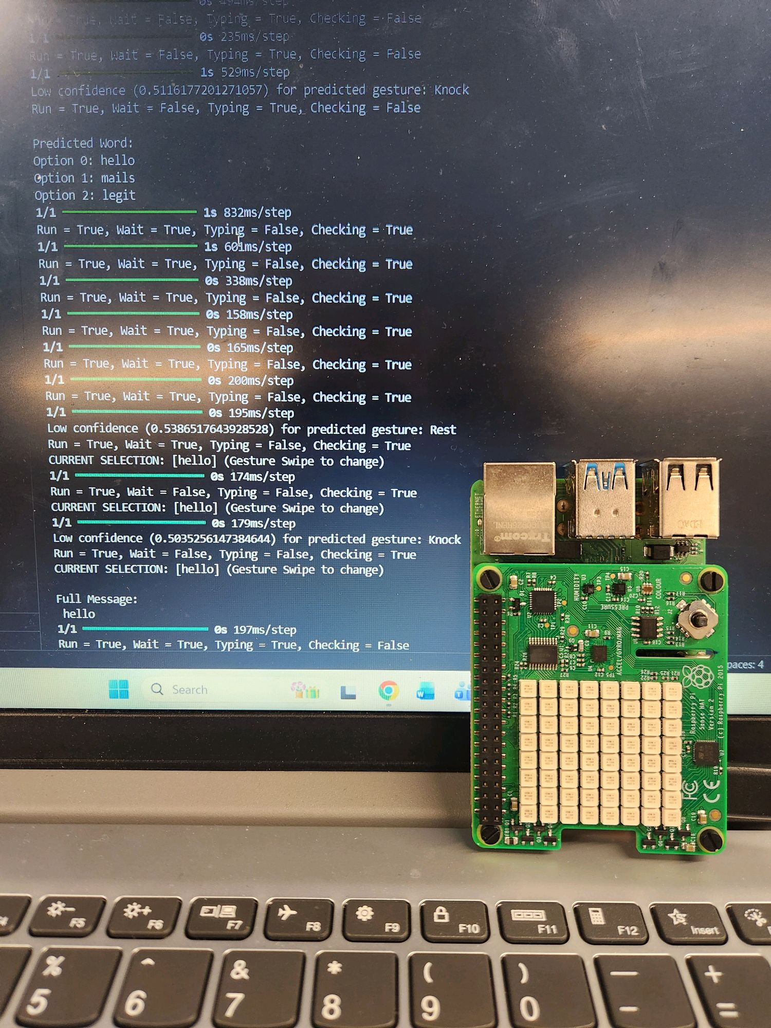
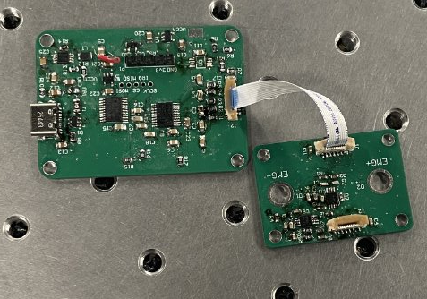
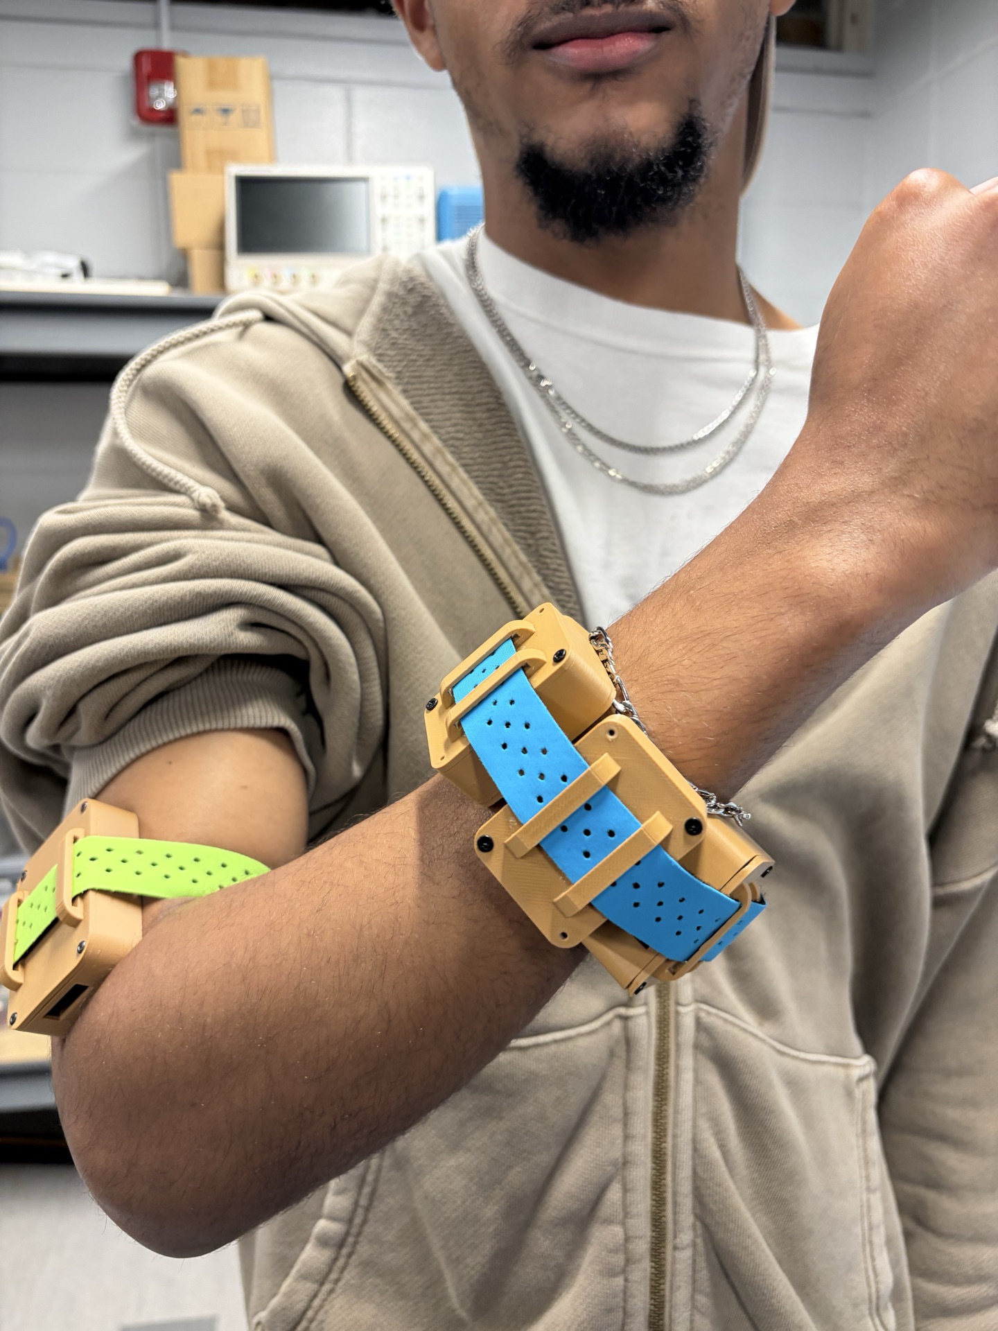
Hardware Prototype: Hardware Images
Control Board
Electrode Board
Control Board

Slide 10
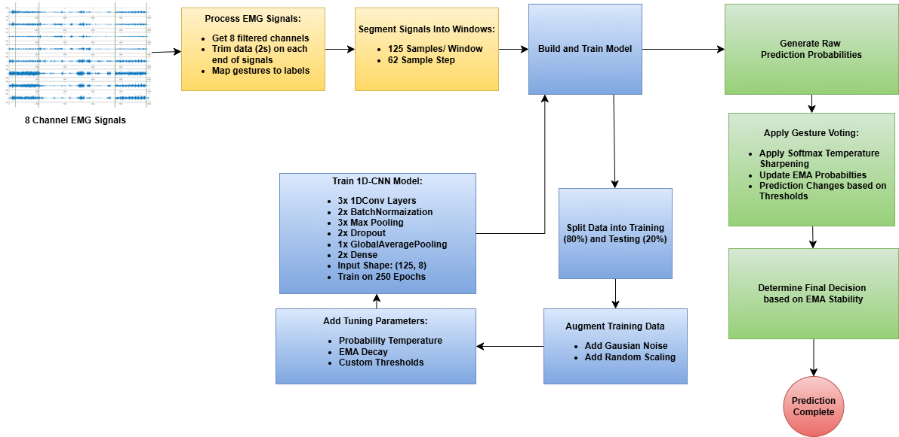

Software and Algorithm: Gesture Prediction Model
Notes:
This figure shows the steps for training our model and generating 1 gesture prediction.
First, 8 channels of EMG data are gathered from the EMG armband. We then pull the data from the filtered channels, trim the 2 seconds of rest from each end of the active gesture signal, and map each gesture to a lab (Ex. Gesture 3 -> Middle Pinch). Then, we segment the signals into windows, with 125 samples/ window and a sample step of 62. This breaks the long streams of data into smaller, more manageable pieces for training.
To build the model, we first split the data into 80% training and 20% testing. Because we lacked volunteers to gather data from, we also augment the data to give the illusion of more samples. To augment the data, we add gausian noise and random scaling to mimic different signal strengths. Because some gestures are stronger than others, we also tune the prediction algorithm to better predict weaker gestures. We use Exponential Moving Average (EMA) to help average prediction weights, probability temperature to control control prediction sensitivity, and custom thresholds to boost weak predictions and weaken strong ones that are over-predicted. Lastly, we build a 3 layer 1D-CNN model with the shown attributes. The model is trained over 250 epochs.
Once the model has trained, we can make a prediction on passed in gestures. To make each prediction, a raw probability score is generated first. Then, the model moves to voting. It applies Softmax Temperature Sharpening to increase prediction confidence, update EMA probabilities, and determine the prediction based on whether or not certain custom thresholds are met.
Final, the final gesture prediction is made based on overall EMA stability.

Slide 11
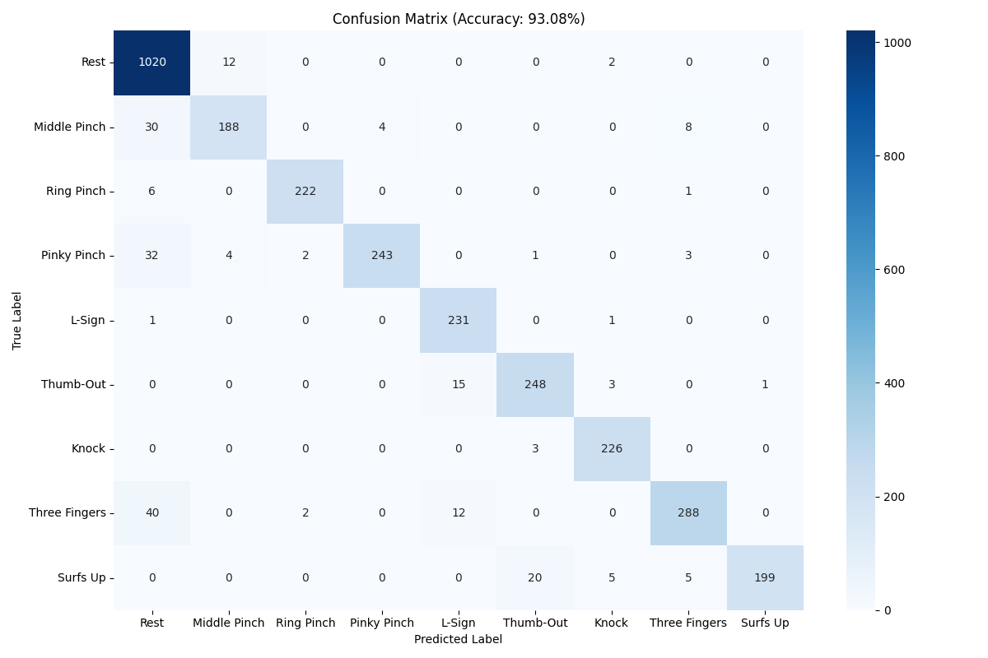
Software and Algorithm: Gesture Prediction Model
Confusion Matrix
Gesture Commands & Accuracies
Gesture | Command | Prediction Accuracy
Rest | - | 98.65%
Middle Pinch | A-F | 81.74%
Ring Pinch | G-M | 96.94%
Pinky Pinch | M-T | 85.26%
Three Fingers | U-Z | 84.21%
L-Sign | Swipe | 99.14%
Thumb-Out | Delete | 92.88%
Knock | Space/ Enter | 98.69%
Surfs Up | Start/ Stop | 86.90%
 | Overall: | 93.08%
Notes:
The results shown are based on new, unseen data taken from a different day/ time from the data the model was trained on. As you can see, the model does a good job of differentiating between each gesture. The most common confusions are with Middle Pinch (Confused with Rest), Pinky Pinch (Weaker so confused with Rest) and Thumb-Out (confused with Surfs Up because similar). The lowest performing gesture is the Middle Pinch, which is ~82% accurate. The highest performing gesture is Knock, which is 98.69% accurate. Overall, the system is ~93% accurate, which met our goal of at least 90% accuracy.

Slide 12
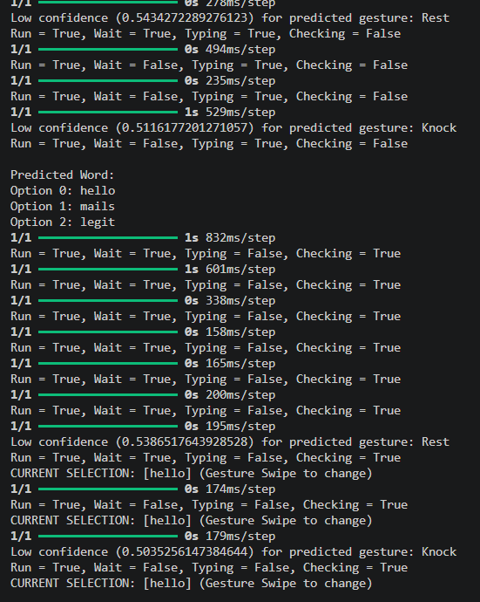
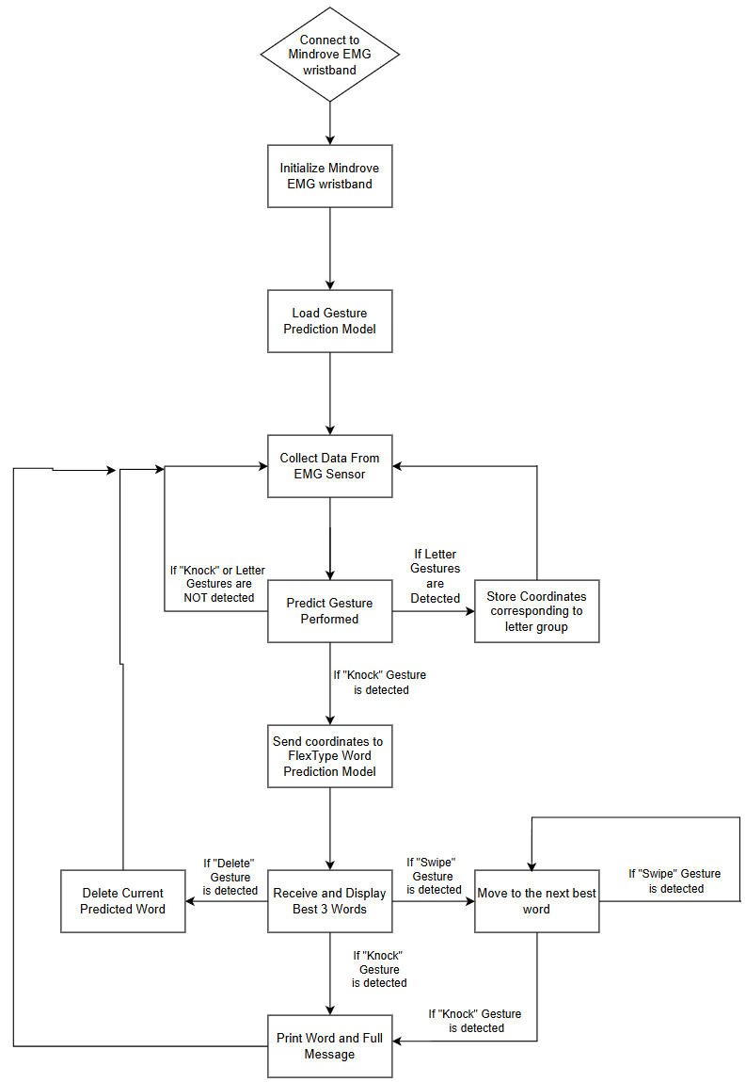
Software and Algorithm: Driver Algorithm
State Diagram
Screenshots from Typing

Slide 13

Live Demo

Slide 14

Remaining Work Before Expo
Software Remaining Work
Fix FlexType API call on Raspberry Pi
Validate Test Cases
"Wake" Typing, Type "Hello" Successfully, End Typing
Type "I am happy" Successfully
Validate "Swipe" and "Delete" Functions during "happy"
Type "I like birds" Successfully
Adjust gesture prediction rate to be smoother/ faster
Clean up terminal output to be less crowded and more user friendly
Hardware Remaining Work
Continue testing the two PCBs to see how accurate the signal we are getting from them are.
Implement the software models with our PCBs to test their accuracy
Expo Preparation
Make Video Demo

